Slide 1


FOOD DEMAND FORECASTING

Slide 2
Contents:
Team Introduction
Problem Statement
Business Understanding
Data Understanding
Methodology
Data Preparation
Model Development
Model Evaluation
Model Delivery/Deployment/Serving
Results
Tools used

Slide 3




Meet the Team
Supraja Kodiganti
ML Engineer
Team Lead
Guna Jaswanth Reddy
Data Scientist
Sumanth Ganimalla
Cloud Engineer
Godswill Ikwan
Data Engineer

Slide 4
Problem Statement
Food companies that have several fulfilment centers/branches spread across different locations nationally are often faced with the problem of planning the right/optimal stock/inventory of ingredients and food raw materials to prepare the optimal amount of food at these food fulfilment centers.
We address this problem by implementing several time series model to forecast the demand for food on a weekly basis where these fulfilment centers are located.

Slide 5
Business Understanding
Demand forecasting is a key component to every growing online business.
Without proper demand forecasting processes in place, it can be nearly impossible to have the right amount of stock on hand at any given time.
A food service company/restaurant must deal with a lot of perishable raw materials which makes it more important for such a company to accurately forecast daily and weekly demand.
Too much inventory in the warehouse means more risk of wastage, and not enough could lead to insufficient resources and push customers to seek solutions from your competitors.

Slide 6
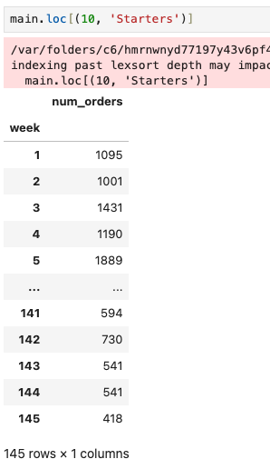
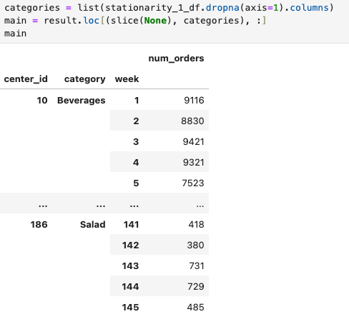
Data Understanding
3 relational tables
Hierarchical structure
77 fulfilment centers
56 meals
14 food categories
146 weeks of data

Slide 7
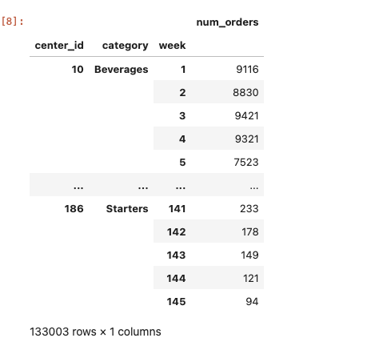
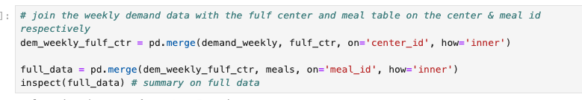

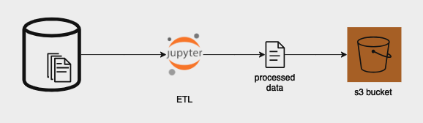
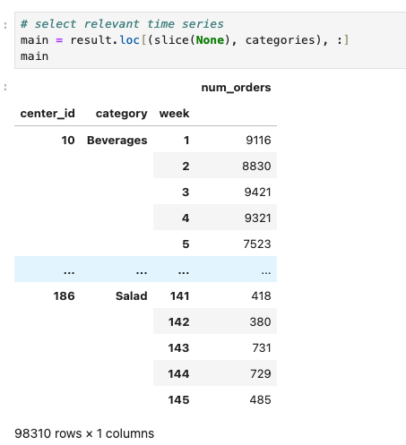
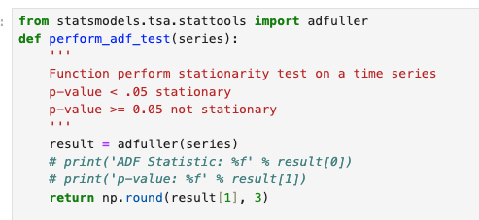
Methodology
Data Preparation
Join operations
Aggregations
Stationarity tests

Slide 8

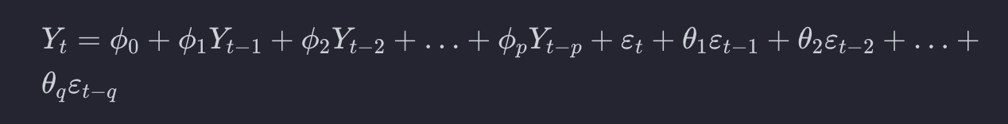
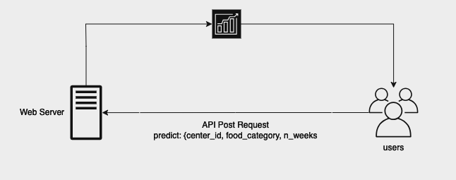
Methodology
Model Training
Used ARMA
We fit 9 time series models
Model Evaluation
Train & Test MAEs
Model residual Plots
Generalized with the evaluation results
Model Delivery

Slide 9
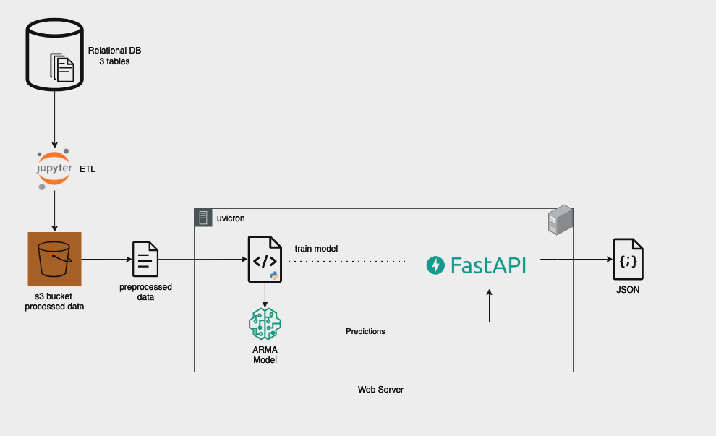
App Structure and Workflow

Slide 10
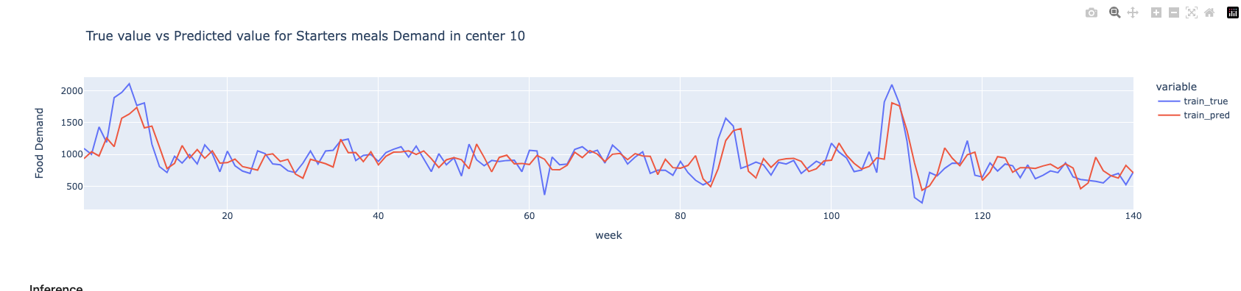

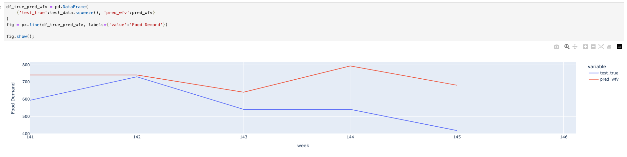
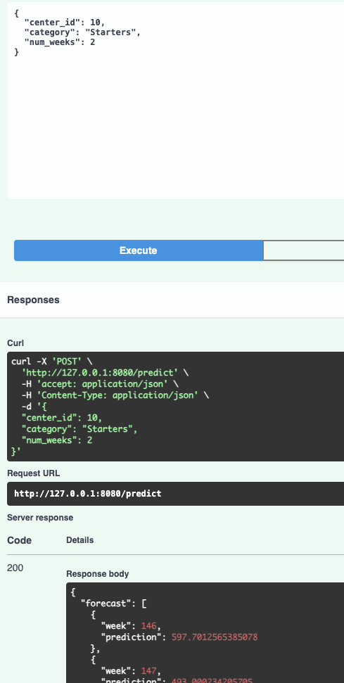
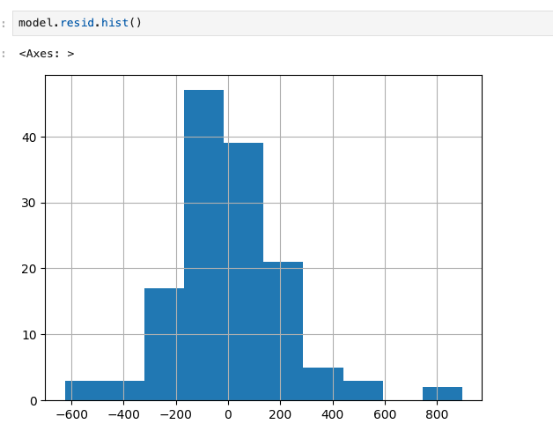
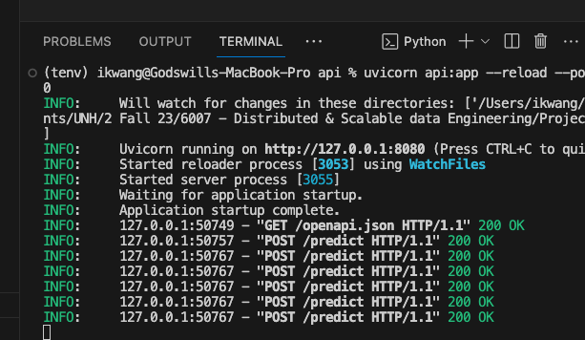
Results

Slide 11
Demo
File was removed because file was too large
Please see video

Slide 12




Tools we used:
Jupyter Notebook AWS S3 Fast API
Python
Uvicorn

Slide 13
THANK YOU

